Slide 1
EMCC Production Scheduling System
Final Presentation

Slide 2
Table of contents
02
07
03
08
04
09
01
About the Project
06
Development Phase
Project Status
Communication
Implementation Plan
Challenges
Requirements Phase
Project Cost
05
Design Phase
10
Conclusion & Recommendations
EMCC - Production Scheduling System

Slide 3
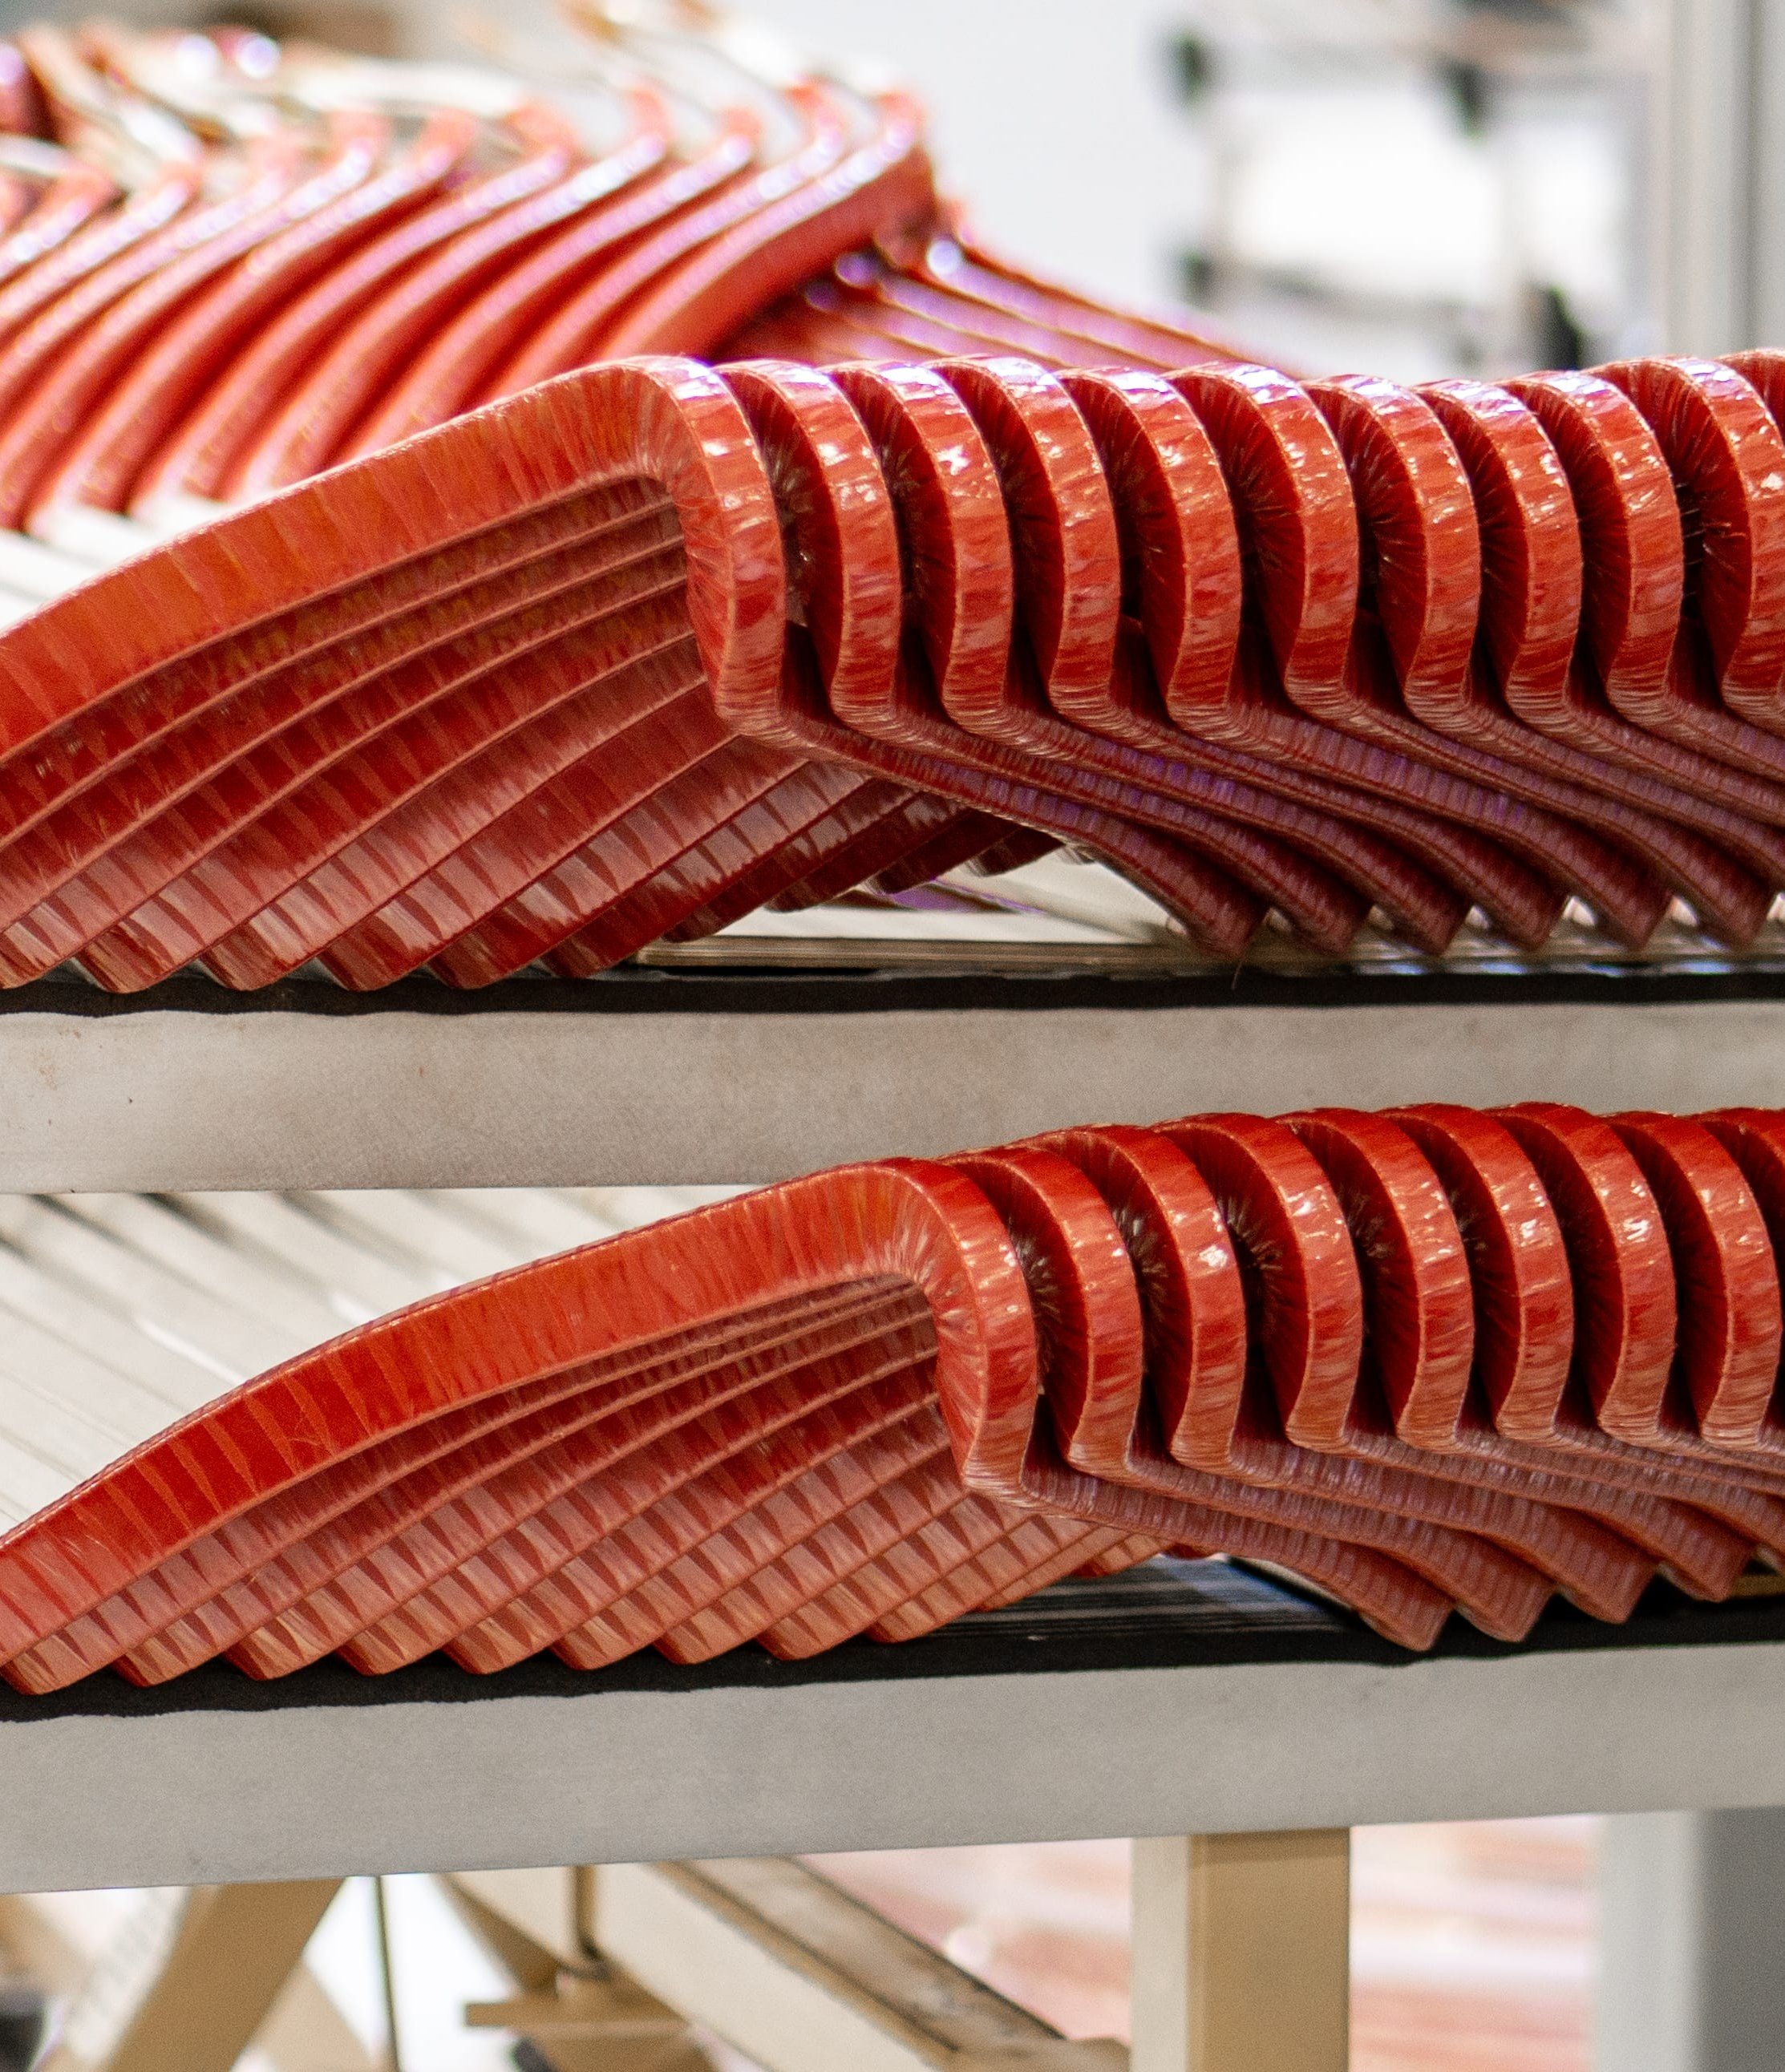
About the Project
01
EMCC – Electric Motor Coil company is a reputed coil manufacturer in Canada.
EMCC would like to develop a Production Scheduling module to their ERP system to aid with scheduling work orders based on a number of factors/constraints such as machine availability, labor capacity, material availability, etc.
EMCC - Production Scheduling System

Slide 4
Project Deliverables
Predictive ML Model
Power BI Dashboard
Analysis Report

Slide 5





Project Status
02
Date of Last Report
Project
Date of Report
Prepared By
Project Status
Production Scheduling System
12th April 2024
27th March 2024
Team Members
Completed
EMCC - Production Scheduling System

Slide 6
Implementation Plan
03
Preparation Phase
Analysis and Development Phase
Reporting Phase
November 30th, 2023
Acceptance of
Project Charter
April 12th, 2024
Handover of the Deliverables Phase
January 15th, 2024
Design Phase
March 26th, 2024
Release Phase
November 16th, 2023
Prepare Project Charter,
Prepare Project Proposal,
Ethics & Data Management Plan
December 7th, 2023
Requirements Phase
February 28th, 2024
Development and Testing Phase
April 12th, 2024
Client Presentation
April 19th, 2024
Project Close-Out Phase
Current Stage
EMCC - Production Scheduling System

Slide 7
Requirements Phase
04
EMCC - Production Scheduling System

Slide 8
Data Received
Downtime
Coil
Stator_data
Scans
Session
Armature
EMCC - Production Scheduling System

Slide 9
Design Phase
05
EMCC - Production Scheduling System

Slide 10

Initial Data Analysis
About Data
The original dataset contained data except for stator_data and armature datasets.
Later, stator_data and armature datasets received.
The data received contains records only for 1.5 years.
EMCC - Production Scheduling System

Slide 11
Development Phase
06
EMCC - Production Scheduling System

Slide 12
Data Cleansing
Inspection & Cleanup
Filling the Missing Data
Enriching Data
Creation of new, insightful features.
Final Dataset
Quick scan for errors or gaps.
Removal of duplicate entries.
Imputation strategies for missing data
Data formatting for consistency
Standardization
Scaling numerical data for uniform analysis
Outlier Management
Identification and treatment of outliers.
Ensuring data integrity and readiness.
EMCC - Production Scheduling System

Slide 13
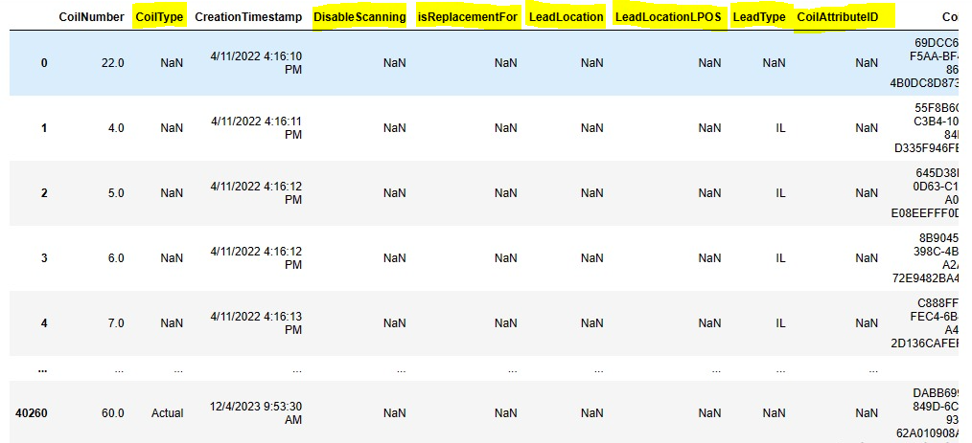
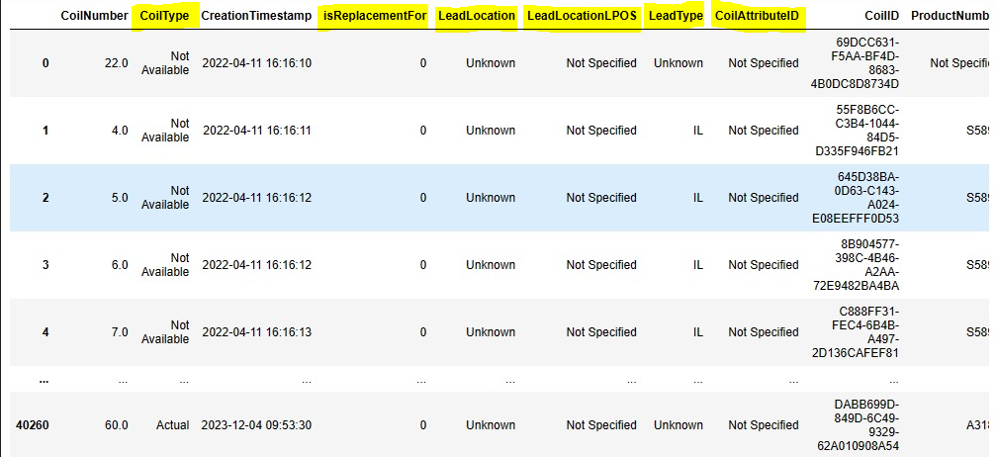
Data Cleansing
Coil dataset – Before data cleansing
Coil dataset – After data cleansing
EMCC - Production Scheduling System

Slide 14
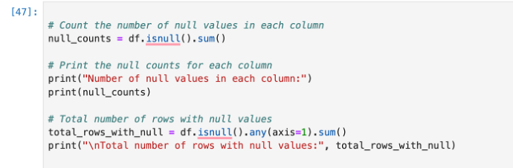
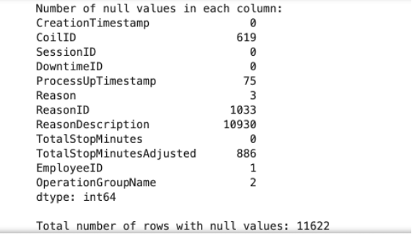
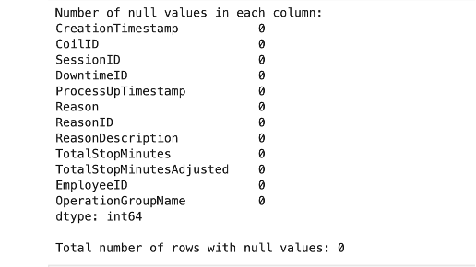
Data Cleansing
Downtime table After cleansing null values
Downtime table before cleansing null values
EMCC - Production Scheduling System

Slide 15
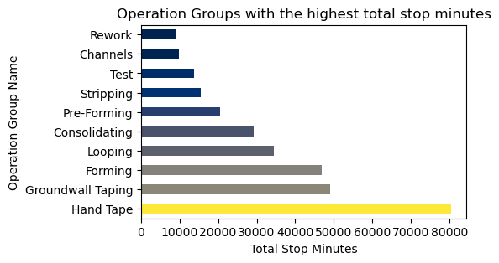
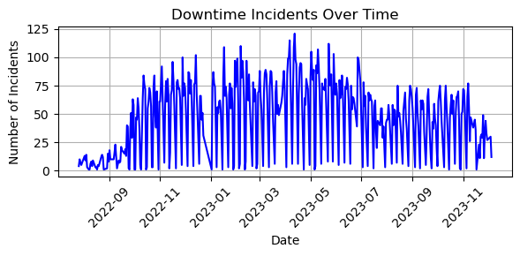
EDA
Hand Tape has the highest downtime followed by GroundWall Taping and Forming.
The duration of system downtime has shown a significant reduction since July 2023, and has remained consistently low thereafter.
EMCC - Production Scheduling System

Slide 16
Regression Model
Predict "Cycle_Time" based on product features:
Coil_type: (actual=0,setup=2),
Number of turns
lead-type
Type of operation.
EMCC - Production Scheduling System

Slide 17
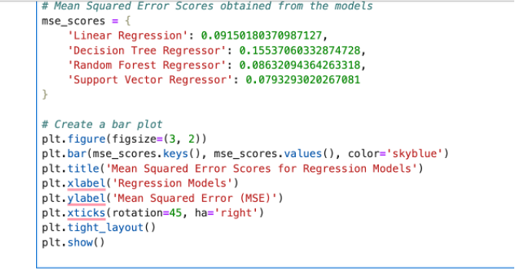
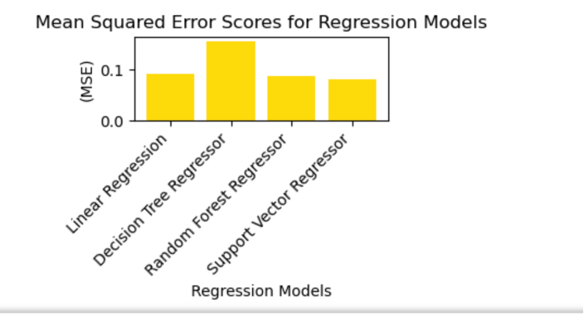
Model Comparisons
EMCC - Production Scheduling System

Slide 18
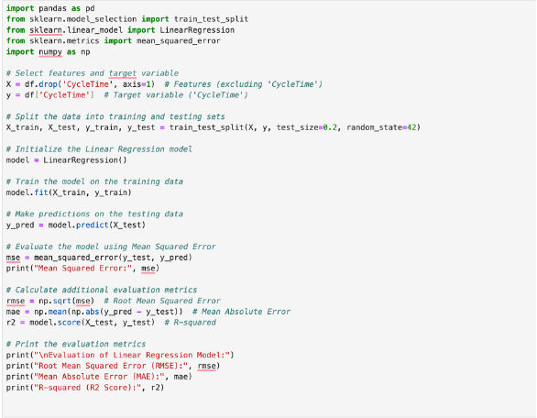
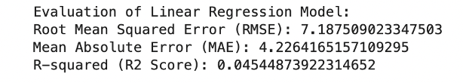
Linear Regression Model
EMCC - Production Scheduling System

Slide 19
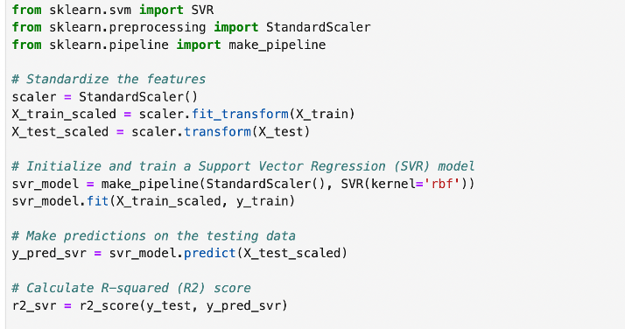
SVR Model
R-squared (R2) Score (SVR): 0.31137994463275553
EMCC - Production Scheduling System

Slide 20
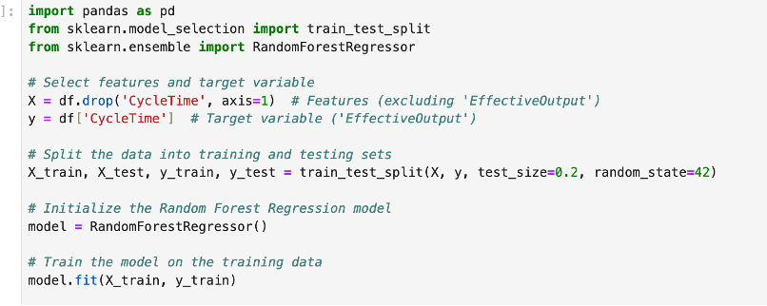
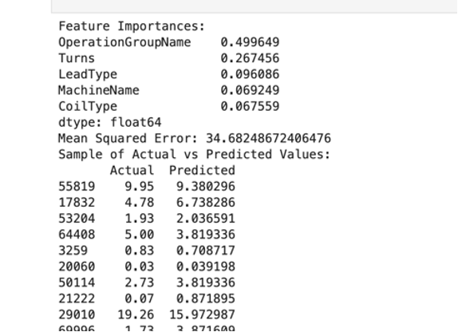
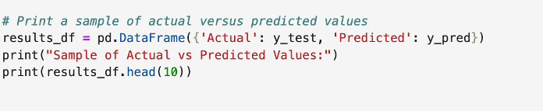
Random Forest Model
EMCC - Production Scheduling System

Slide 21
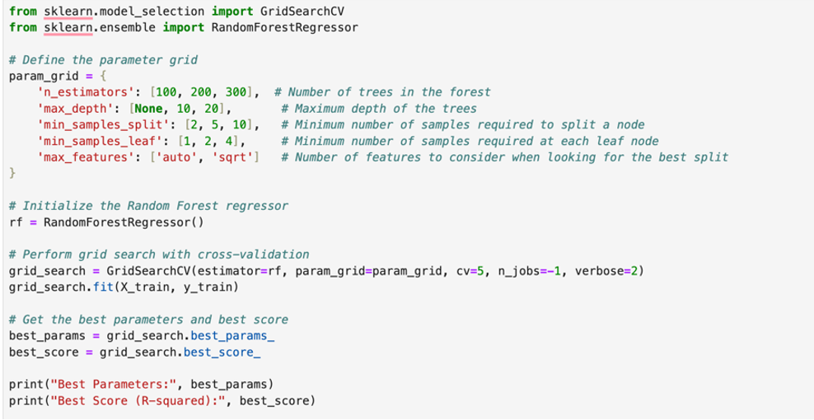
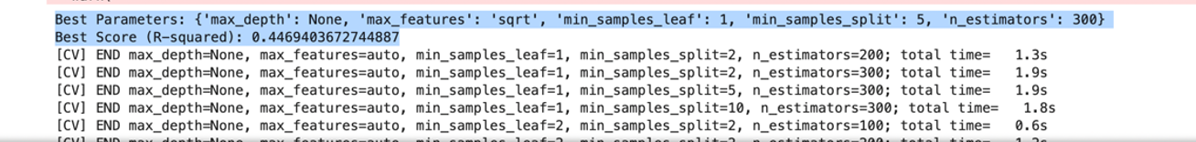
Hyperparameter Tuning, Grid Search
EMCC - Production Scheduling System

Slide 22
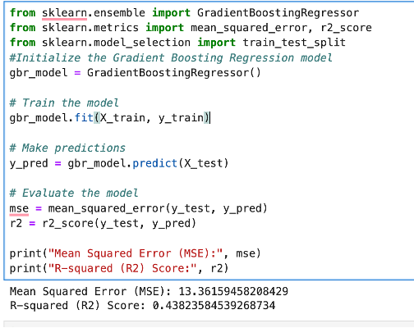
Gradient Boosting Regressor
EMCC - Production Scheduling System

Slide 23
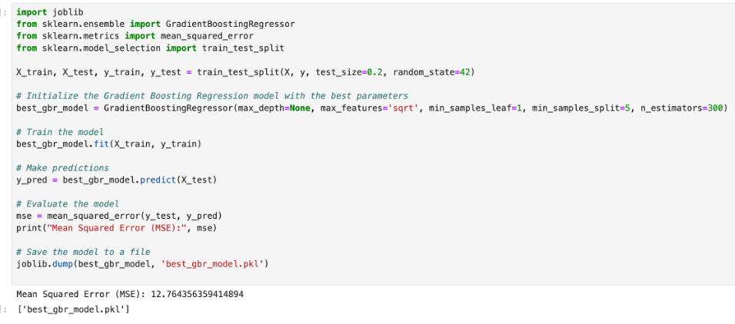
Final Regression Model
EMCC - Production Scheduling System

Slide 24
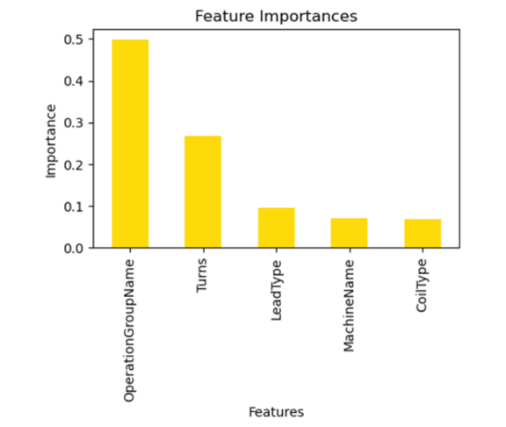
Top 5 Feature Importance
EMCC - Production Scheduling System

Slide 25
Development Phase Tasks
Data Acquisition
Data Preprocessing
Feature Engineering
Exploratory Data Analysis (EDA)
Model Selection & Training
Model Evaluation
Final Model Selection
Model Tuning
Model Deployment
EMCC - Production Scheduling System

Slide 26
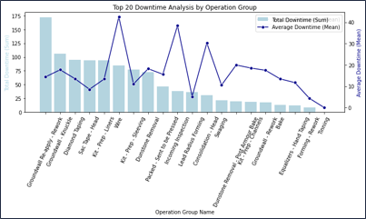
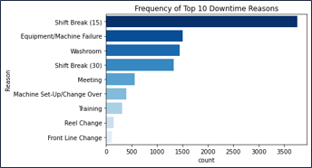
EDA Cntd.
'Shift Break' is the most frequent cause, followed by 'Washroom' and 'Equipment Failure', and 'Reel Change' being the least frequent reason.
'Hand Tape' and 'Ground Wall Taping' are the operation groups experiencing the highest total downtime, with 'Hand Tape' leading significantly in accumulated downtime.
EMCC - Production Scheduling System

Slide 27
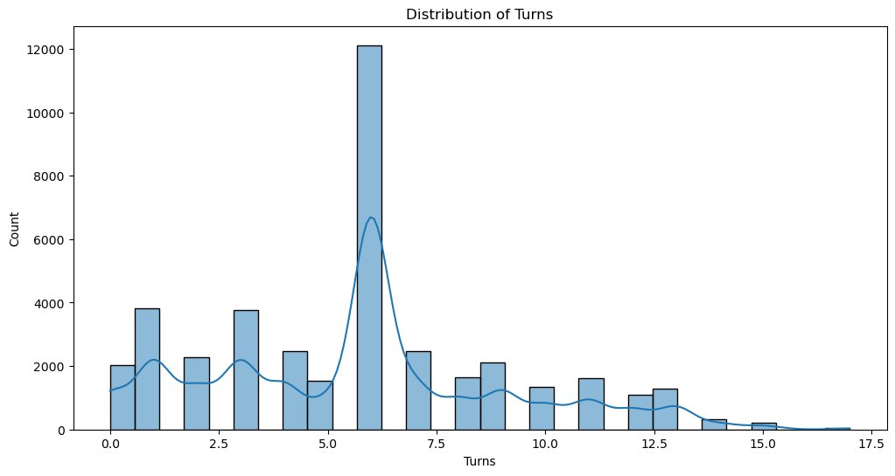
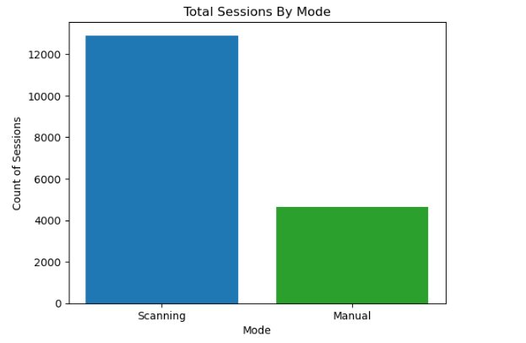
EDA Cntd.
Majority of the sessions have been executed during the daytime compared to Afternoon and Night sessions.
Coils between 5 to 7 turns are the most common, with around 12,000 instances, whereas coils with 15 or more turns are significantly less frequent.​
EMCC - Production Scheduling System

Slide 28
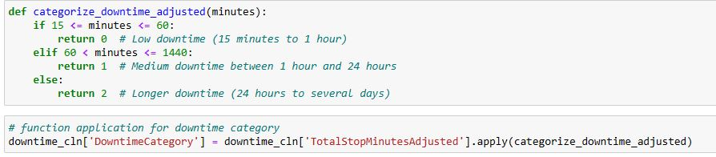
Classification Models: Downtime Category Prediction
The three classes of downtime:
0 - Low downtime (15 minutes to 1 hour).
1 - Medium downtime that lasts anywhere between 1 hour and 24 hours.
2 - Long downtimes that can last from 24 hours to sometimes even several days.
EMCC - Production Scheduling System

Slide 29
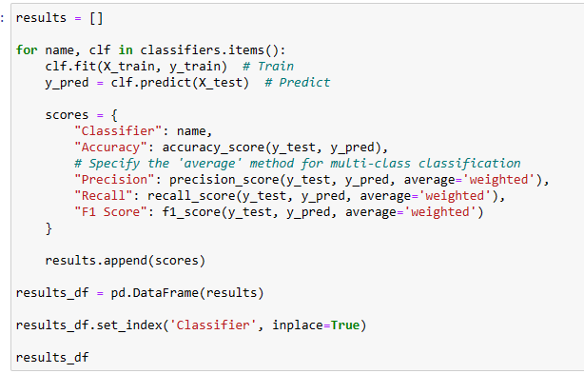
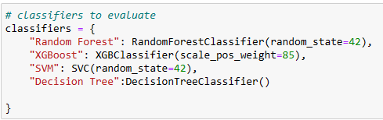
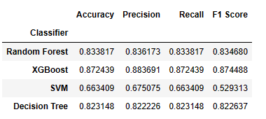
Model Comparisons
EMCC - Production Scheduling System

Slide 30
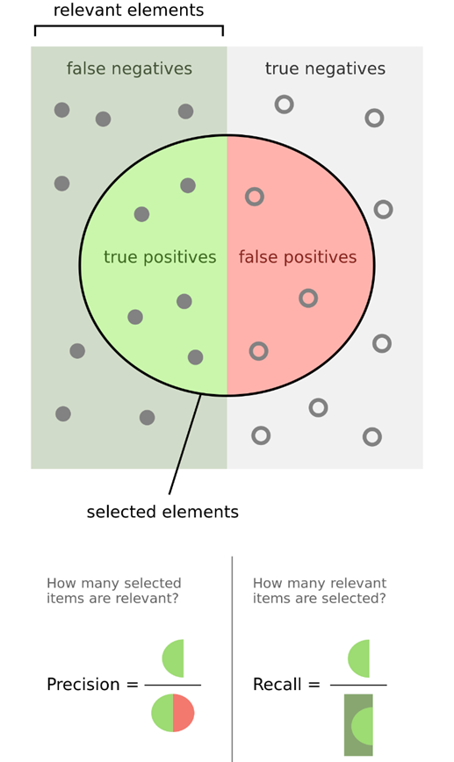
Scoring Metrics
 |  | Predicted
 |  | No | Yes
Actual | No | True Negatives Predicted Coils without Downtime & Coils without Actual Downtime | False Positives Predicted Coils with Downtime but No Actual Downtime
 | Yes | False Negatives Predicted Coils without Downtime but Coils with Actual Downtime | True Positives Predicted Coils with Downtime & Coils with Actual Downtime
EMCC - Production Scheduling System

Slide 31
Why Recall?
Recall measures the model's ability to correctly identify all actual downtimes.
In downtime prediction, missing an actual downtime (false negative) can be costlier than predicting a non-existent downtime (false positive).
High recall minimizes missed downtimes, crucial for operational efficiency and safety.
EMCC - Production Scheduling System

Slide 32
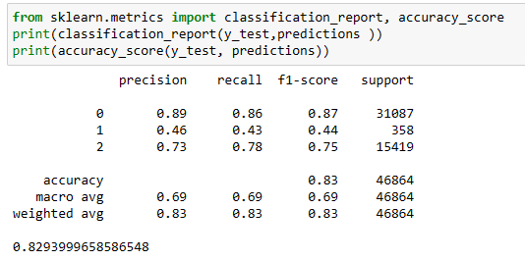
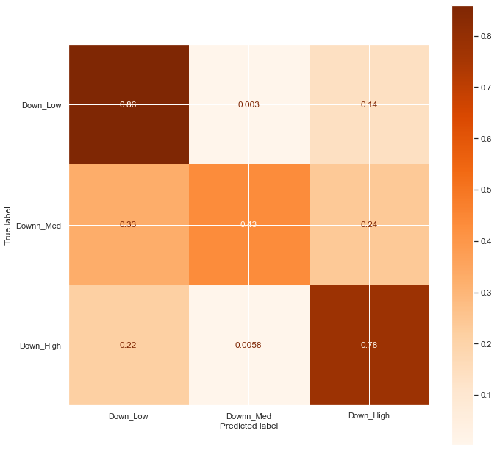
Random Forest Model
EMCC - Production Scheduling System

Slide 33
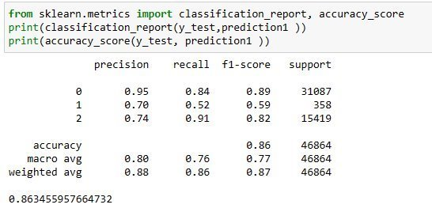
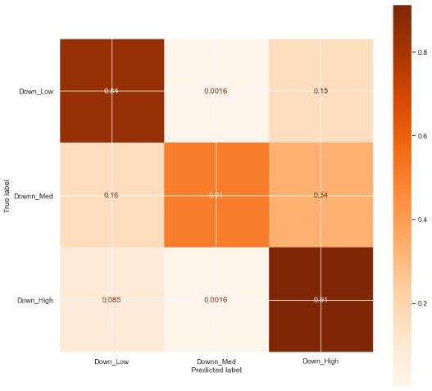
XgBoost Model
EMCC - Production Scheduling System

Slide 34
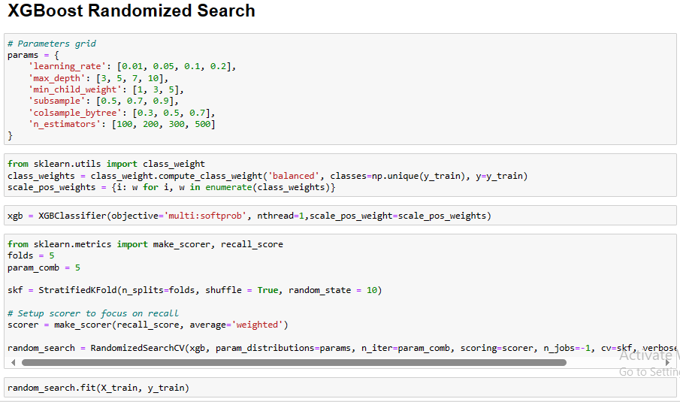
Hyperparameter Tuning – Randomized Search for XGBoost
EMCC - Production Scheduling System

Slide 35
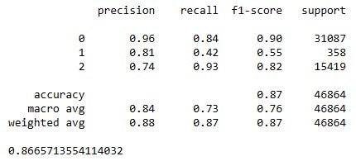
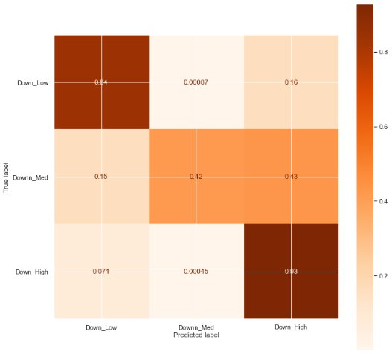
Final Model Selection
EMCC - Production Scheduling System

Slide 36
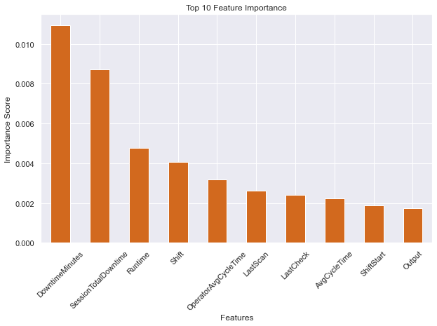
Top 10 Feature Importance
EMCC - Production Scheduling System

Slide 37
EMCC Dashboard
EMCC - Production Scheduling System

Slide 38
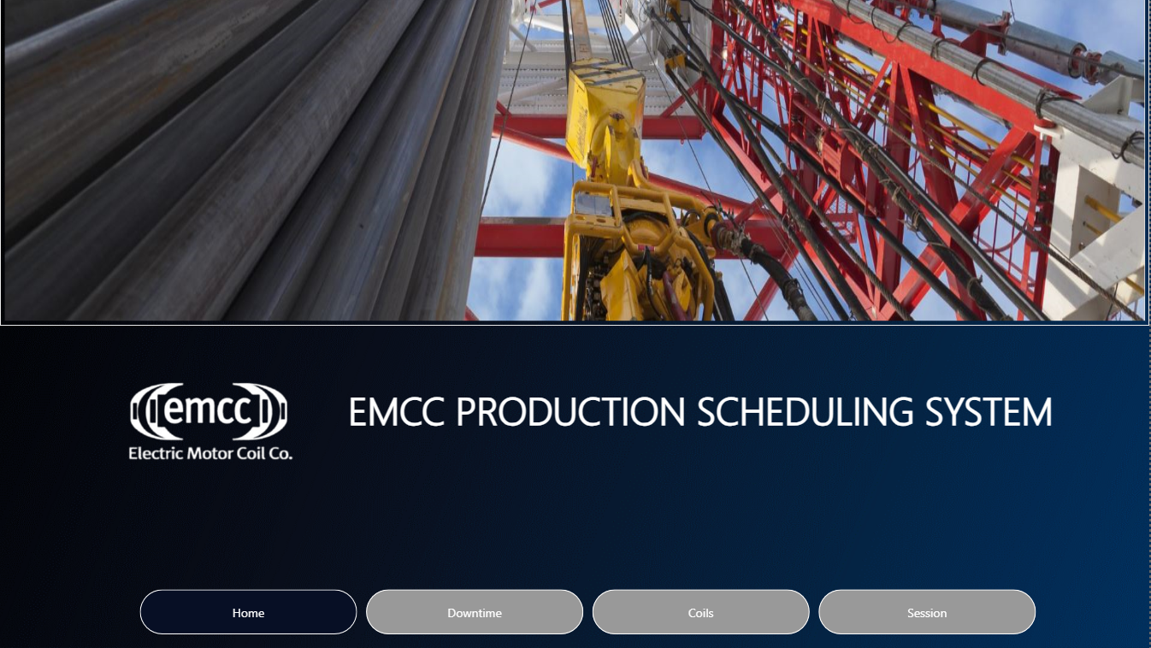
EMCC - Production Scheduling System

Slide 39
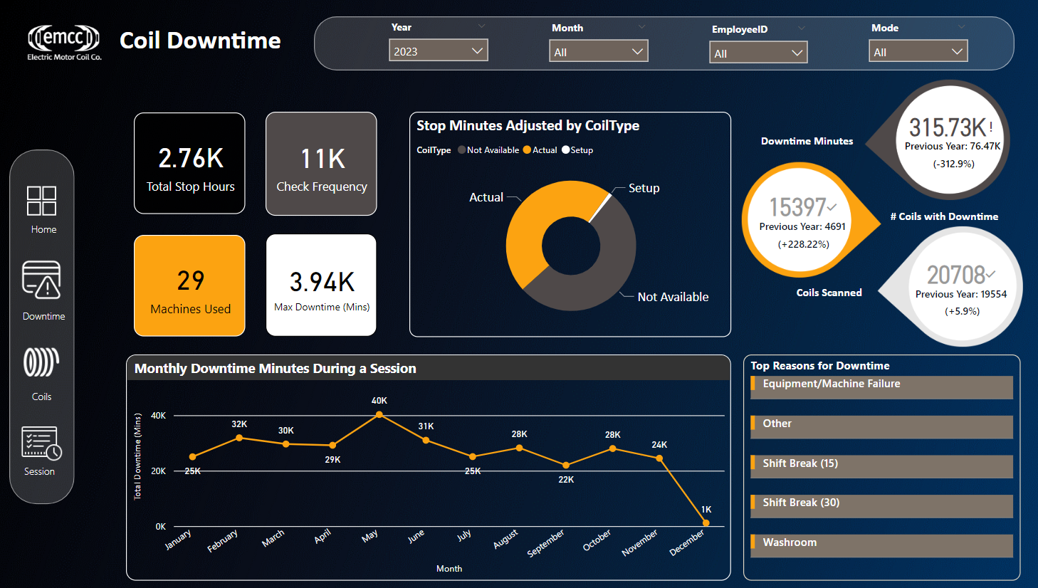
EMCC - Production Scheduling System

Slide 40
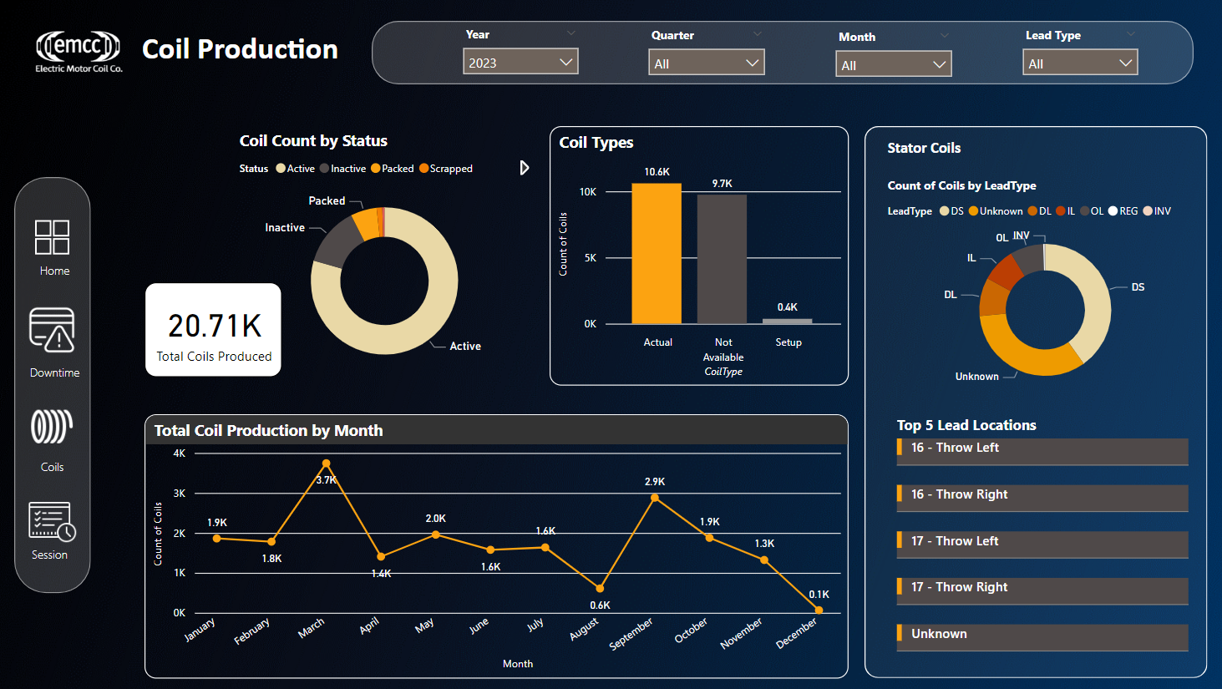
EMCC - Production Scheduling System

Slide 41
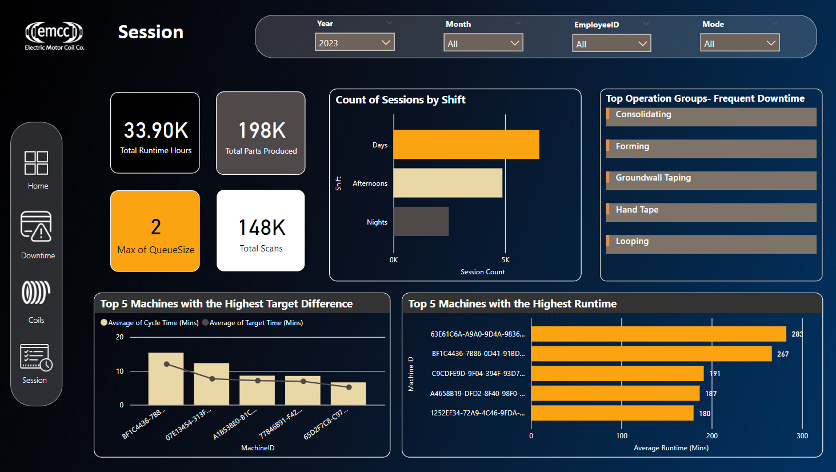
EMCC - Production Scheduling System

Slide 42
08
Challenges/ Issues
Limited Data (Duration : 1.5 years)​​
Changed the model building approach from time series to semi-supervised to supervised model.​​
Overfitting
Received additional data.​​
Hyper parameter tuning.​​
Cross Validation.
EMCC - Production Scheduling System

Slide 43
Project Cost
09
Total Budgeted Hours: 191
Total Actual Hours: 159
Total Cost: $7950
EMCC - Production Scheduling System

Slide 44
Conclusion
10
Successfully adopted the XGBoost model, enhancing our ability to predict low and long operational downtimes with high accuracy.
Identified crucial downtime influencers, such as session duration and shift patterns, laying a solid foundation for strategic operational enhancements.
Recognized and addressed difficulties in predicting medium downtime, emphasizing the ongoing need for broader datasets and innovative analytical methods.
Launched an intuitive dashboard providing a comprehensive overview of production metrics, enabling proactive decision-making and operational optimization.
The insights and lessons from this project are steering the development of more resilient operational strategies, leveraging data analytics to strengthen the productivity and competitive advantage.
EMCC - Production Scheduling System

Slide 45
Recommendations
⁠1. Process Mapping: Map out current processes to understand how tasks are being performed and where delays occur.
Process Identification - Identifying the specific process.
Start and End Points.
Main Activities, Sub-activities.
Sequence of Activities.
Decision Points - For example, if a defect is found during testing, the decision point could be whether to rework the coil or scrap it.
Inputs and Outputs.
Roles and Responsibilities - For instance, the quality control department may be responsible for testing coils for defects.
Information Flow - For instance, test results may need to be communicated to the production team for further action.
EMCC - Production Scheduling System

Slide 46
Recommendations
2.Streamlining Processes:
Simplify and optimize processes by eliminating redundant steps and automating repetitive tasks where possible.
⁠3.Standardization:
Establish standardized procedures to ensure consistency and efficiency.
EMCC - Production Scheduling System

Slide 47
Thank You!
EMCC - Production Scheduling System

